Slide 1


Rediscovering OIN
— The First 20 Years
Introducing OIN 2.0
— A New Frontier
February 2026

Slide 2



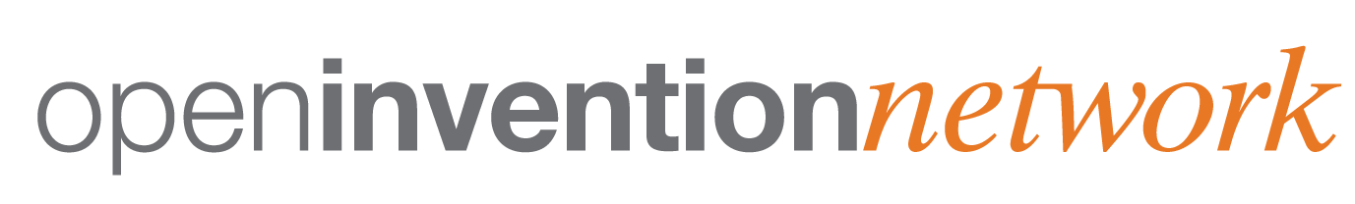
SAFEGUARDING OPEN SOURCE: EMPOWERING INNOVATION THROUGH COLLABORATION
20 Years: Our mission has not wavered. We protect Open Source Software (OSS), enable freedom of action & reduce patent risks.
Funding Members
Worldwide Licensees
4100+
Starting in 2005, 8 full member companies contributed
$160 million (USD) in capital & strategic patents to create OIN.
We’ve exceeded 4,100 worldwide members in 157 countries. Our community has experienced 42% annual growth, Membership has been free for all, with operations supported by the funding members.
Linux System Definition
5100+
Open
Source Zone
50+ Patents Busted
Our exclusive cross license — the world's largest & oldest defensive cross license — protects 5,100+ core Linux &
Open Source technologies through our evolving Linux System definition.
We founded & have been the key financial supporter behind the Open Source Zone which has invalidated 46 patents, instituted 4 & initiated reviews on others
since 2019.
Patent
Holdings
3 Million+
Defensive
Strategies
$50 Million
In 20 years, OIN has built a community that owns 3+ million active patents & applications. We’ve been — and remain — the world’s only institution dedicated to protecting Open Source from patent attacks.
We’ve sold $50 million in patents to our members defending them from patent aggressors. We neutralize patent threats & mitigate patent risks through many other defensive strategies.

Slide 3

STRATEGIC GUARDIAN FOR OPEN SOURCE SOFTWARE
OIN 2.0 Defends Against Patent Risks for the Future
Our cross-license is unparalleled as an active patent license.
It has been demonstrated to successfully protect OIN’s 4,100+ community members.
It doesn’t require a condition or trigger,
Becoming self sustaining will allow us to continue serving OIN members & the Open Source community. Monitoring and addressing patent threats requires a multifaceted approach and a specialized skill set.
OIN is committed to
serving as the strategic guardian to protect Open Source Software from
patent threats.
Our comprehensive Linux System definition continues evolving to cover new technologies, but this requires ongoing stewardship to review nominations and maintain the list as software is released.
OIN is focused on protecting Open Source from all patent aggressors, including Non Practicing Entities (NPEs).

Slide 4
PROTECTING OPEN SOURCE AGAINST PATENT THREATS & LITIGATION
OIN Takes a Multifaceted Approach to Address
Non-Practicing Entity (NPE) Threats
OIN Cross-License
Additional Strategies
OIN actively tracks Open Source Software litigation to help protect our members.
We have used the following strategies to address specific NPE threats:
OIN Member sells patents to a NPE
4,100+
Corporate Members
NPE
Reexaminations & Inter Partes Reviews (IPRs)
Non-Infringement Analysis / Claim Charting
Prior Art collection & sharing
Third Party Preissuance submissions
Member aggregations to drive discounted licensing terms vs bilateral deals
Defensive patent purchases
Various other strategies to mitigate patent risk
3 Million+
Patents &
Applications
Other OIN Members remain licensed in Linux System technologies, protected from that NPE
87% of NPE patents originate from corporate entities

Slide 5


INTRODUCING OIN 2.0
Driving Global Impact —
The OIN Community Economic Reach
In 2025, the OIN Community collectively generated an estimated revenue of $10.1 trillion (USD), equivalent to:
⅓ of the United States’ GDP, or
½ of China’s GDP, or
½ of the EU’s GDP, or
2.5x India’s GDP, or
2.5x Japan’s GDP
This underscores the massive size of the OIN community, and how the OIN cross-license in the Linux System presents a great opportunity for OIN members to continue to protect themselves from patent risk in Open Source Software (OSS) technologies they rely upon.

Slide 6
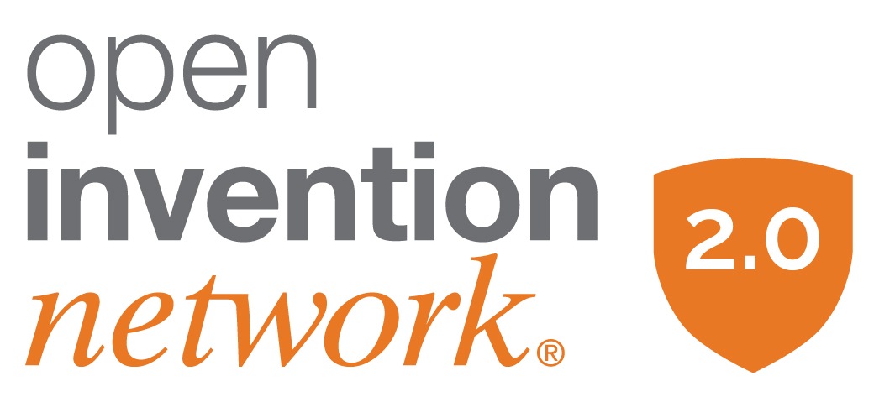
INTRODUCING OIN 2.0
Working for You —
OIN’s Comprehensive Defense Strategies
Massive OIN
Cross-License
4,100+ licensees that own 3 million+ patents and applications, and generate $10 trillion dollars (USD)
in total revenue.
Living Linux System
Definition
Safeguarding members in 5,100+ Open Source packages & applications, which will grow over time to meet the challenges of patent risk in new Open Source technologies
Open Source
Patent Protection
Shielding the ecosystem from costly Non-Practicing Entity (NPE) litigation when stakes are higher than ever as NPE cases rose 20% in 2024.
Proactive Intellectual Property (IP) Defense
Strategies like reexaminations/IPRs, prior art, invalidity analysis & threat monitoring reduce global patent risks.
Protection for Your Key Technological Resource
Open Source transitioned from questionable viability in 2005 to 90% of companies now relying on Open Source as mission-critical in today’s enterprise. Harvard Business School estimates that companies would pay 3.5x what they pay for software today if open source did not exist.

Slide 7
INTRODUCING OIN 2.0
OIN 2.0 — The Next Chapter
Stability. Scalability. Shared Responsibility.
We’ve expanded Linux System Table 13 — and will continue to expand future tables — to protect new Open Source Software (OSS) technologies, including smart technologies, security, networking, data centers, & automotive.
To continue & build on our accomplishments, OIN implemented a Tiered Annual Participation Fee starting on January 27, 2026, with the expansion of Table 13 of the Linux System.
Table 13 increases coverage for Cloud Computing, Kubernetes & Eclipse projects.
Table 13 expands coverage for modern languages by adding many new libraries for Go, Python & Rust.
Existing OIN members can keep their free original license for Linux System definition Tables 1-12, but:
Open Source Software (OSS) is growing exponentially into new areas.
OIN 2.0 will sustain our strategic mission & vision.
The average defense cost against Non Practicing Entities (NPEs) is ~$4 million (USD) with the median cost of $5 million for claims >$25 million.
The value of OIN 2.0 is far greater than the annual participation cost, which is also less than many other membership organizations.

Slide 8
INTRODUCING OIN 2.0
Annual Participation Fees
The OIN 2.0 License Agreement – along with its Tiered Annual Participation Fee -
was implemented on January 27, 2026.
Tier 1
Annual Company Revenue
> $500 million
$24K
(USD) per year
Annual Company Revenue
$100-500 million
$16K
(USD) per year
Tier 2
Tier 3
Annual Company Revenue
$50-100 million
$8K
(USD) per year
Tier 4
Annual Company Revenue
$10-50 million
$1K
(USD) per year
Annual Company Revenue
< $10 million; includes individuals
$0
(USD) per year
Tier 5

Slide 9
ACTIVELY REDUCING PATENT RISKS
A Call to Action — Securing the Future Together
As Open Source evolves & faces new patent challenges, your participation in OIN
is crucial.
By joining OIN 2.0, you ensure continued protection for your Open Source technologies & the broader ecosystem.
Membership fees directly fund:
Expanded Protection — Broader Linux System coverage for new &
emerging technologies.
Sustained Defense — Patent risk monitoring, re-exams & other
defensive strategies.
Cost Avoidance — With patent defense averaging $4M+, OIN membership is a smart investment.
Community & Innovation — Strengthening the world’s largest Open Source patent community.
Ongoing Stewardship — Maintaining & updating the Linux System Definition.
Strategic Security — Advancing OIN toward self-sustainability to proactively protect members.
Upgrade your
membership
Support the world’s leading defense against patent threats to Open Source Software. Help to clear patent risks in the technologies that your company uses & relies upon. Together, we’ll protect Open Source technologies & empower innovation for years to come.
Sign up to OIN 2.0 here: https://openinventionnetwork.com/join-oin-2-0/

